Slide 1
NEW MAIN PROVISIONS OF ENTERPRISE LAW 2014

Slide 2

PURPOSE OF AMENDMENT
  Make the enterprise a CHEAPER AND SAFER business tool
  Better promote the investment attraction and mobilization of all resources and capital for production and trading business

Slide 3
NOTEWORTHY POINTS OF ENTERPRISE LAW 2014
  Reducing risks for enterprises;
  Promoting activeness and creativeness in business;
  Reducing time and cost of enterprise-related administrative procedures;
  Reducing cost and increasing flexibility in business management;
  Better protecting investors;
  Renewing management of state-run enterprises;
  Social enterprises.

Slide 4
I. REDUCING RISKS FOR ENTERPRISES

Slide 5
1. Realization of freedom to do business
01/07/2015
Enterprise law 2005 Enterprise law 2014
Business registration certificate
Enterprise registration certificate
SPECIFIED fully every category of business
Does not specify Category of business
Doing business strictly in the registered areas which were specified in the business registration certificate
Free to do business in any area that the LAW does not prohibit.

Slide 6
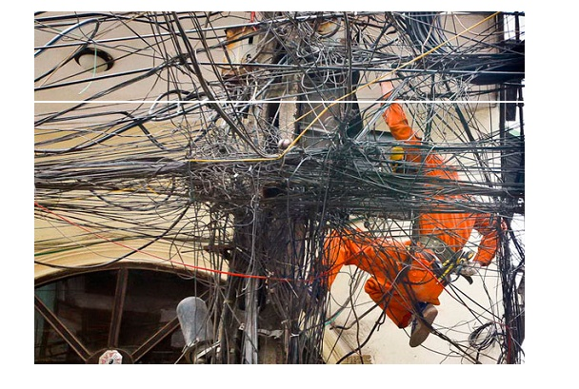

2. Transparency of provisions on prohibited and conditional business
Prohibited business (6)
Conditional business (267)
Free to do business in other type of businesses

Slide 7
II. PROMOTING THE ACTIVENESS AND CREATIVENESS IN BUSINESS

Slide 8
Reform in business management
(starting business first and then inform the authority latter)
Before 1 July 2015
Decided by the enterprise
Register, change or add more types of business
Start business
After 1 July 2015
Decided by the enterprise
Start business
Change or add more types of business
Notes:
Business registration information is only for the purpose of statistics

Slide 9
III. REDUCING TIME AND COSTS IN FULFILING ADMINISTRATIVE PROCEDURES

Slide 10
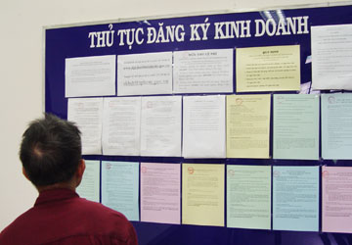
1. Simplification of business registration
Business registration certificate = “a birth certificate” for the establishment of an enterprise; not a licence to do business
Denunciation of conditional requirements for doing business at the time of enterprise registration: professional practicing certificate + legally required capital
Shorten procedural processing time to 3 working days
Uniform business registration procedure applicable to both domestic and foreign investors

Slide 11

2. Reform in stamp-related procedures
Change in method of stamp management
Change in procedure applicable to the making of stamp, stamp registration (Government Decree No. 58/2001/ND-CP) by a requirement to publication of stamp specimen (Decree No. 96/2015/ND-CP guiding the implementation of Enterprise Law)
Enterprise shall determines by itself:
  The number of stamp: unlimited in number
  Modality of stamp: triangle, multi-angular or others
  Content of the stamp
  Management and use of stamp
Existing stamp:
  Continue using
  Returned and make a new one

Slide 12
3. Consolidation, merger, division, splitting of enterprise
Expanding types of enterprise to be consolidated, merged, divided and splitted. It allows companies of the same nature (maybe different in the organizational structure) to be consolidated merged, divided, splitted.
Detailed instructions on the process and procedure for consolidation, merger, division, splitting of enterprise and re-registration after being consolidated, merged, divided and splitted.
Clearer and more suitable provisions on process and procedure of enterprise dissolution – automatic procedure:
  Dissolution decision;
  Publication of existing circumstance of to-be-dissolved enterprise;
  Property liquidation; and
  Deletion of enterprise name

Slide 13
IV. REDUCING COSTS AND INCREASING FLEXIBILITY IN BUSINESS MANAGEMENT

Slide 14

1. Legal representative
Company may have 1 or more legal representatives
The company charter shall specify the rights and obligations of legal representatives.
Information of legal representatives shall be specified in Business Registration Certificate
Legal representatives

Slide 15

2. Shortening the time limit for making contribution to chartered capital in case of limited liability company and joint stock company
Shorten the time limit for completing capital contribution to limited liability and joint stock company to 90 days
Register the change in company chartered capital after completing payment for capital contribution/shares

Slide 16

3. Simplifying initial private offering process
Supplement provisions on initial private offering for joint stock company, which is not a publicly listed company, regulate this issue more appropriately and simpler than Enterprise Law 2004 did.
Notice provided to enterprise registration authority is mainly to publish information about initial private offering

Slide 17
4. Loosing conditions for meetings of board of members
Enterprise law 2005 Enterprise law 2014
65%
First time
51%
Second time
X%
Third time
65%
First time
X%
Last time or otherwise provided by the charter
Meeting
Meeting
Notes:
The charter may provide otherwise.

Slide 18
5. Lowering the rate of voting in the adoption of decision by board of members
Enterprise law 2005 Enterprise law 2014
65%
Normal decisions
75%
Important decisions
< 65%
Normal decisions
< 75%
Important decisions or otherwise provided by the charter
Voting
Voting

Slide 19
6. Loosing conditions for meetings of General Meeting of Shareholders
Enterprise law 2005 Enterprise law 2014
65%
First time
51%
Second time
X%
Third time
51%
First time
33%
Second time
X%
Third time
Meeting
Meeting
Notes:
First convention: There must be shareholders representing at least 65% of voting shares;
Second convention 2: There must be shareholders representing at least 51% of voting shares.
Third convention: The convention of meeting is considered lawful regardless of the number of shareholders presenting at the meeting.

Slide 20
7. Lowering the rate of voting for adoption of resolution by General Meeting of Shareholders
Enterprise law 2005 Enterprise law 2014
65%
Normal decisions
75%
Important decisions
51%
Normal decisions
65%
Important decisions
Voting
Voting

Slide 21
8. Free to choose enterprise management model for joint stock company (current model)
☺ ☺ ☺ ☺
General Meeting of Shareholders
Board of Directors
Control board
Director/ Director General
Notes:
Board of Directors: consisting of executive & non-executive member
Non-executive members are usually members from boards which are responsible to the enterprise operation and management. This model better facilitates non-executive member to exercise their duty: As a member of Board of Director, they are require to involve in almost of activities of the Board of Directors.

Slide 22
9. Free to choose management model for joint stock company
General Meeting of Shareholders
Board of Directors
Member
Independent member
Director/ Director General

Slide 23
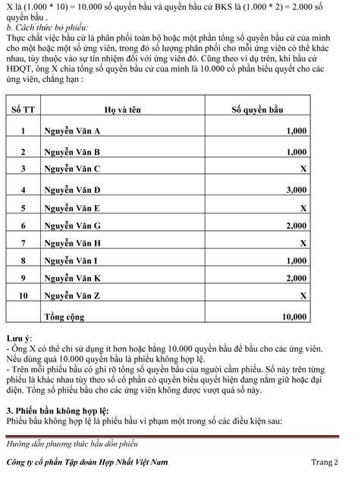
10. Free to choose method of accumulating votes

Slide 24
11. Effect of company’s Resolution and Decision
Resolution and decision shall be effective from the date determined in such resolution or decision
Where the adopted resolution or decision is disputed over its validity, such resolution or decision shall continue to be effective until the court or arbitration tribunal decides otherwise.

Slide 25
12. Legal effect of agreements made by shareholders or board members

Slide 26
13. Effect of contract on conversion of shares

Slide 27
14. Control board of joint stock company
  The rights of control board are specified in detail and widened.
  Invitation to a meeting or absentee ballot sent to members of Board of Directors as well as it attached documents must also be sent to members of Control Board at the same time and in the same manner as applicable to member of Board of Directors.
  Chief of Control Board shall work independently and must be an auditor or professional accountant.
  In a company where the State holds more than 50% of the chartered capital, member of the Control Board must be an auditor or accountant.

Slide 28
15. Providing favorable conditions for application of information technology in company management
It shall be considered to attend the meeting in the following circumstances:
  Attending and casting vote via online video conference, casting vote electronically or by using other electronic means;
  Sending ballot to the meeting by post, fax or email.
Delivery of meeting-related documents in connection with the invitation to the meeting may be made by posting on the company’s website.

Slide 29
16. Information publication of joint stock company
Deliver financial statement in accordance with accounting regulations
Publish on website:
  Company Charter
  Personal information of members of Board of Directors, members of Control Board, Director or Director General
  Annual financial statement
  Annual operation evaluation report of Board of Directors and Control Board
Company of which the State owns > 50% of chartered capital => the information publication shall be made in the same manner as foreign company’s.

Slide 30
V. BETTER PROTECTION OF INVESTORS

Slide 31
What is shareholder protection
Responsibility of managers
Easy to suit against managers
Rights of shareholders
Information publication
Composition of company management agency
Transparency in company management

Slide 32
2. It is easy for the shareholder to file a lawsuit
Enterprise law 2005 Enterprise law 2014
  File a lawsuit directly or on behalf of the company against the manager
  Reasonable litigation costs shall be reimbursed by the company in case of wining the lawsuit.
Court
Without Control Board
With Control board
Shareholders

Slide 33
3. Limiting cross-ownership
New provisions of Enterprise Law 2014:
  Subsidiaries are not allowed to make capital contribution to or buy shares of parent company
  Subsidiaries of the same parent company are not allowed to make capital contribution or to buy shares to establish cross-ownership
  Subsidiaries of the same parent company, of which the State owns >65% chartered capital, are not allowed to make capital contribution to establish a new enterprise.

Slide 34
THANK YOU!
Phan Duc Hieu
Deputy Director, Central Institute for Economic Management, Ministry of Planning and Investment
Nguyen Hung Quang
USAID GIG project consultant –NHQuang & Associates

